Slide 1
Mastering your Business Intelligence with Power BI
Data Modelling
Query Editor
DAX Functions
Measures
Reporting
Visualization
Analysis
Share & Collaborate
Dashboards
Sehrish Aqeel
www.aisciences.io

Slide 2
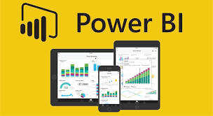
What is Power BI?
Power BI is an interactive data visualization software product developed by Microsoft with primary focus on business intelligence. It is part of the Microsoft Power Platform.

Slide 5


Slide 6
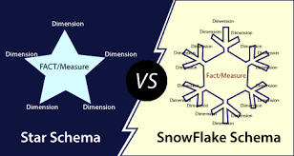
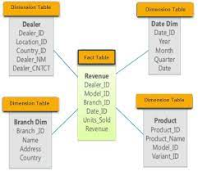

Slide 7
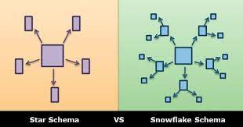
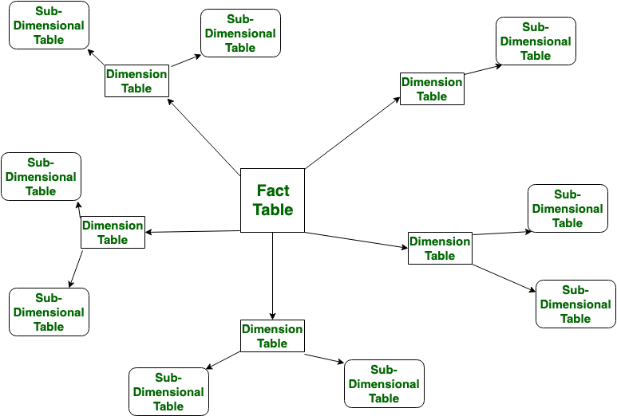

Slide 8
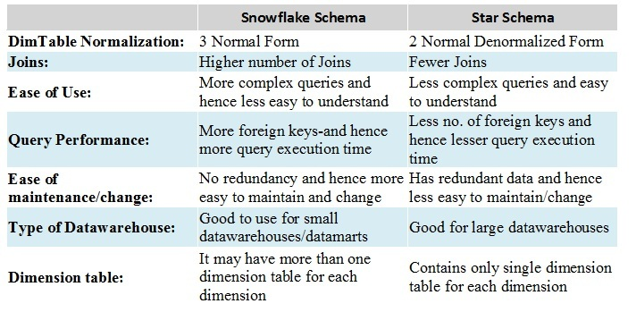

Slide 9
Quiz
Create a measure to calculate sum of sales amount for given data set.

Slide 10
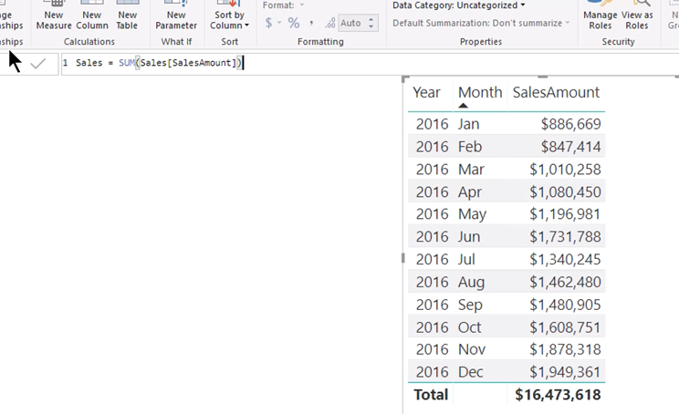

Slide 11
Quiz
Create Implicit measures to calculate the sum of sales.

Slide 12
Quiz
Apply formatting on total sales so that it should represent the total in dollars with zero decimal places.

Slide 13
Quiz
Which one is preferable? Implicit measure or explicit one?

Slide 14
Quiz Solution

Slide 15
Quiz
Create a visual to display the sum of sales amount.

Slide 16
Quiz
Display sales as per year. Show individual values of Year field.

Slide 17
Quiz
Apply basic filtering on the year field to just show the year 2016.

Slide 18
Quiz
Add month field in-between year and sales amount to show slice and dice accordingly.

Slide 19
Quiz
Sort the month field to start a year from Jan and end in Dec.

Slide 20
Quiz: Mini Project
TASKS TO DO:
Display the sum of the budget amount.
Change the formatting of the budget to display the amount in dollars with zero decimal places.
Add the year field to the visual.
Apply basic filtering on the year field to represent the year 2016.
Add the month field to the visual.
Sort the month field to start from Jan and End in Dec.

Slide 21
Quiz
Add visual representing country-wise total sales.

Slide 22
Quiz
Add visual representing month-wise total sales and budget amount of the year 2016.

Slide 23
Quiz
Create a new column in the “Sales” Table named “Total Sales” amount having the sum of “sales amount” and “tax amount”.

Slide 24
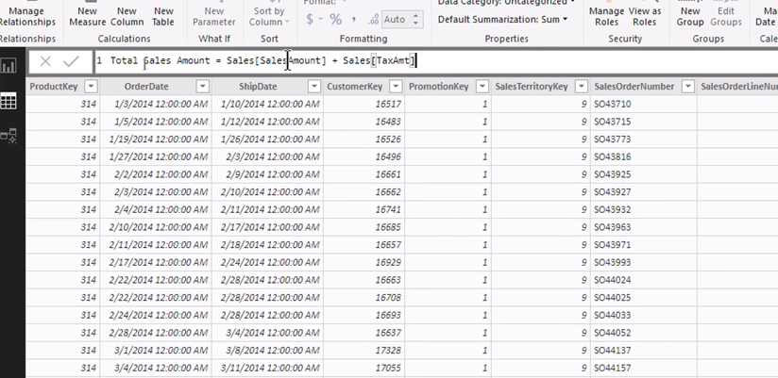

Slide 25
Measure vs Calculated Column

Slide 26
Quiz
Create explicit measures to calculate the sum of sales amount.

Slide 27
Quiz
Create explicit measures to calculate the sum of budget amount.

Slide 28
Quiz
Create explicit measures to calculate the sum of budget amount.

Slide 29
Quiz
Create a hybrid measure named variance that should have difference of sales amount and budget amount.

Slide 30


Slide 31
Quiz
Create a measure using an already created measure of variance to calculate variance percentage. You are required to use the DIVIDE function too.

Slide 32
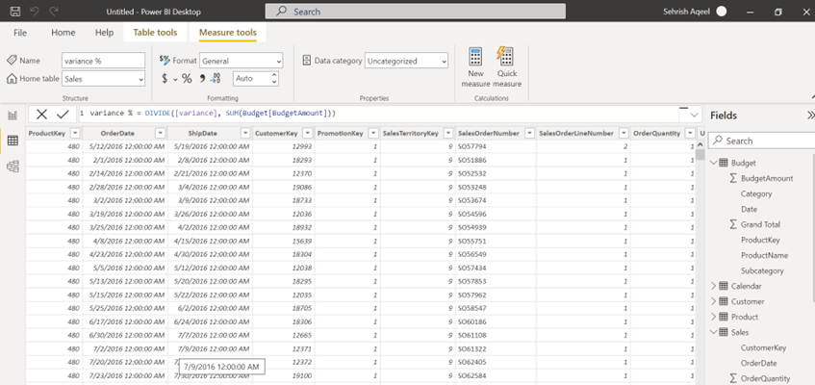

Slide 33
